Slide 1
Material Identification
Image Classification
Tim Fuger
March, 2022

Slide 2
Project objective:
To develop a Convolutional Neural Network that can properly identify material types for warehouse and scrap material handling.
Notes:
We are predicting machine failure to

Slide 3



Project objective:
Receiving Material from suppliers
Storing Scrap in racks
Quality Control check at machines
Notes:
We are predicting machine failure to

Slide 4
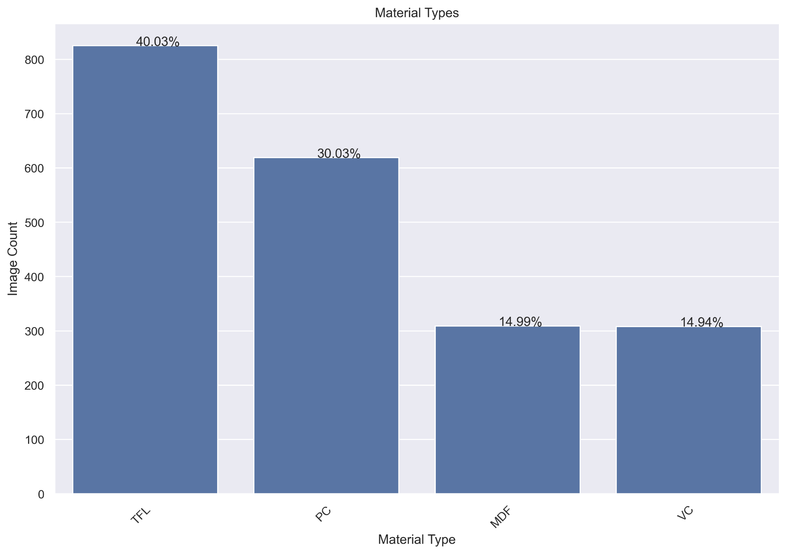
Data
2064 images in total, divided into 4 classes
TFL and PC are the most common images as they are the most common materials used in the factory

Slide 5
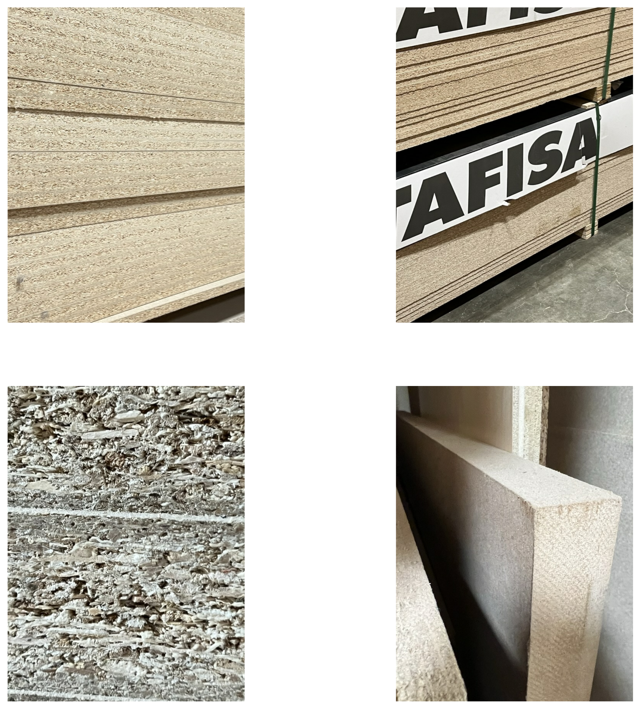
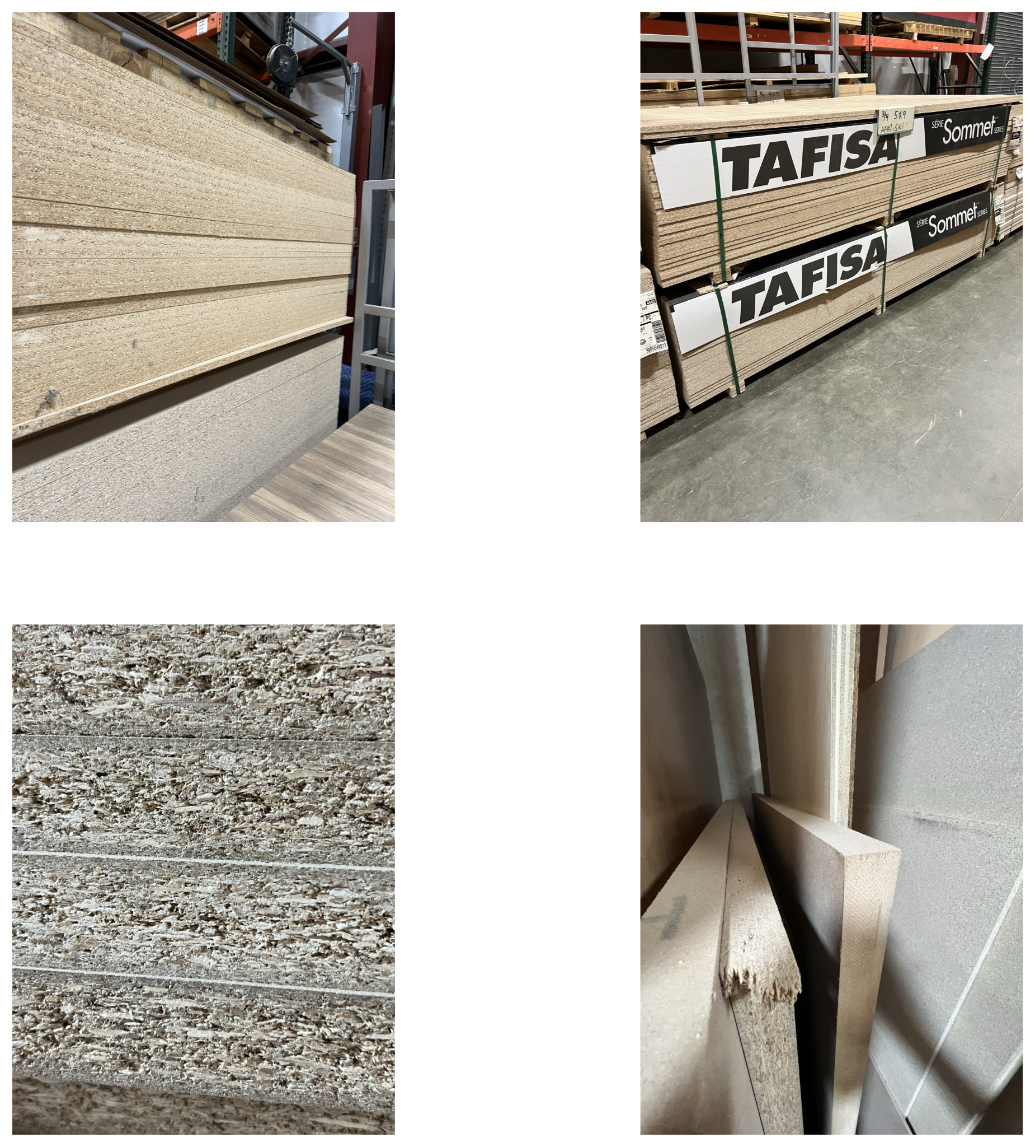
Data Collection
Notes:
Images taken over the course of one day at the facility.

Slide 6
Data Collection
Images taken from a variety of viewpoints in varied lighting conditions
Human identified class of material centered in each image
Notes:
Images taken over the course of one day at the facility.

Slide 7
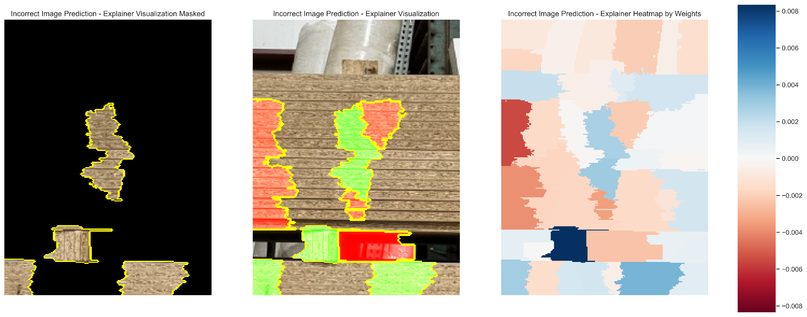
Data

Slide 8
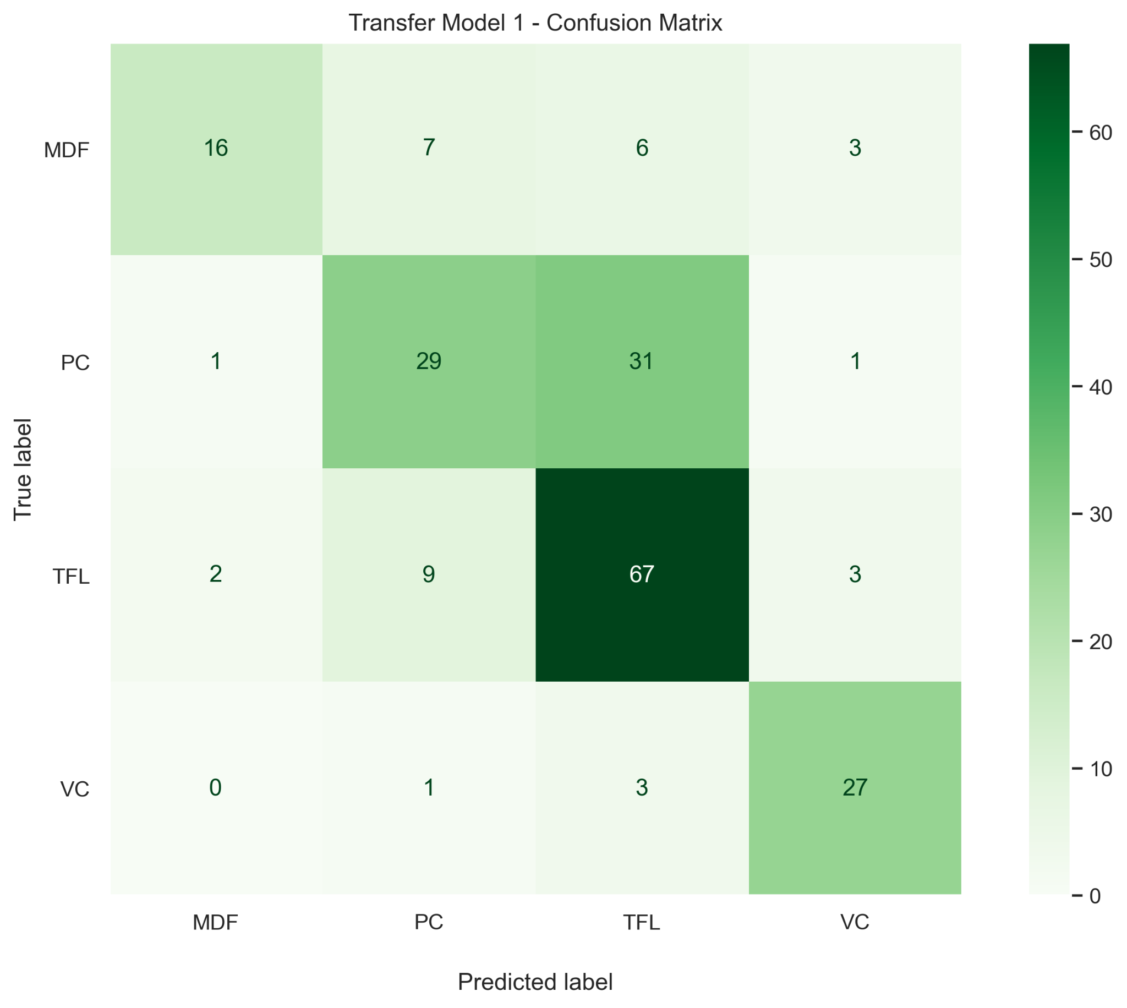
Results
Metrics
Accuracy
67%

Slide 9
Conclusions
Background in images caused noise in classifying images
Difficulty predicting the difference between TFL and PC
Multiple materials in one image created issues in correct predictions
Even with inconsistent data, we were able to come close to required 70% accuracy at the final model’s 67% accuracy
Human oversight required for the initial testing period

Slide 10
Future Work
1
2
3
Collect consistent image data by utilizing a standard hardware and lighting setup across all three work intervals
Increase amount of data to train on by gathering 10,000 or 20,000 images
Better accuracy could be obtained by fine tuning the final model to the first two points presented here

Slide 11
THANK YOU

Slide 12
APPENDIX

Slide 13
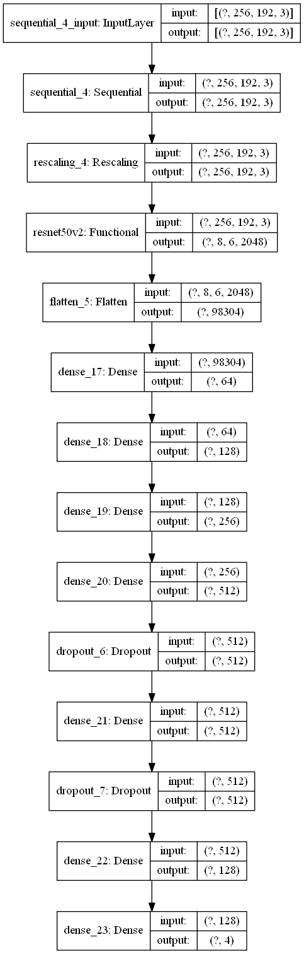
Data

Slide 14
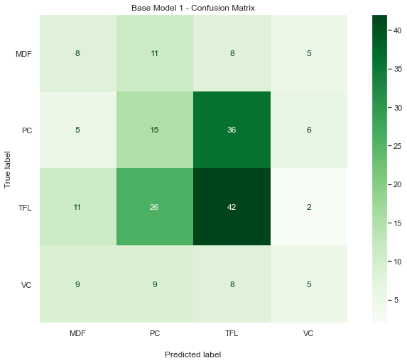
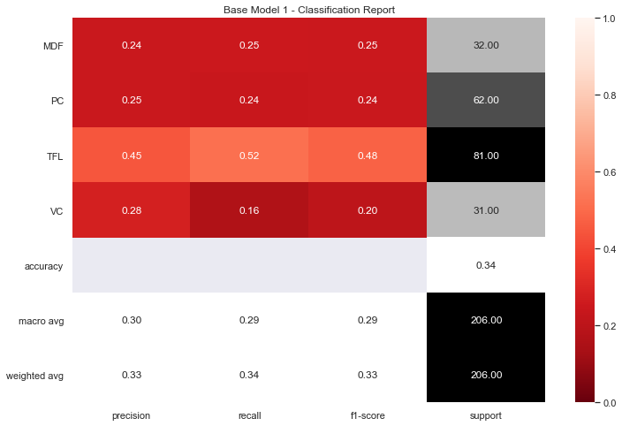
Data

Slide 15
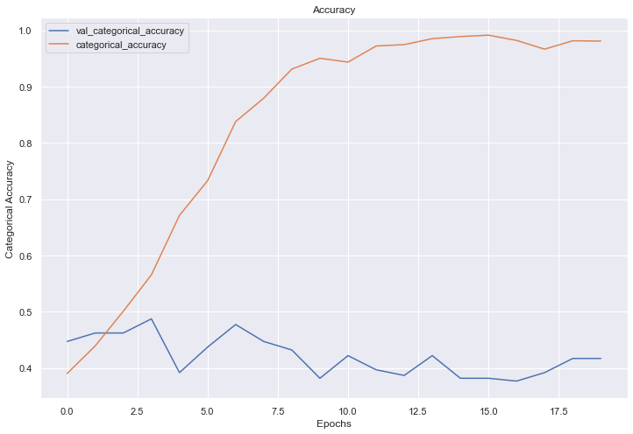
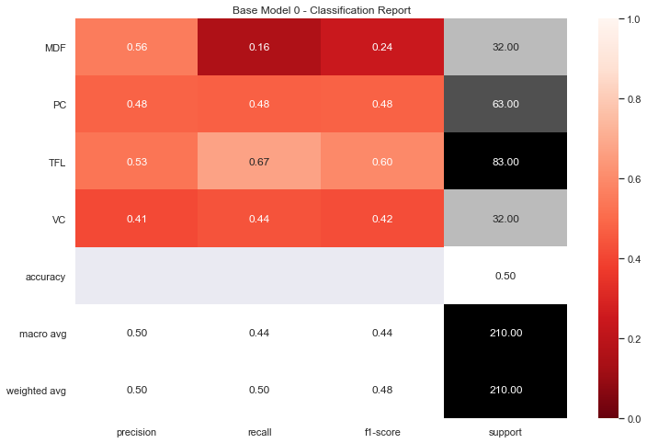
Data

Slide 16
Data

Slide 17
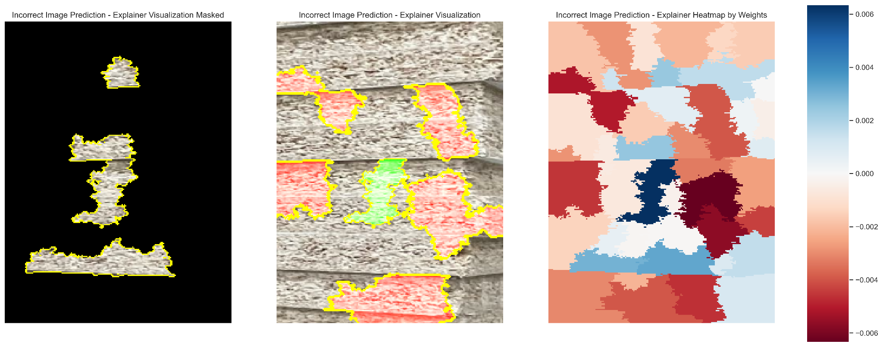
Data

Slide 18
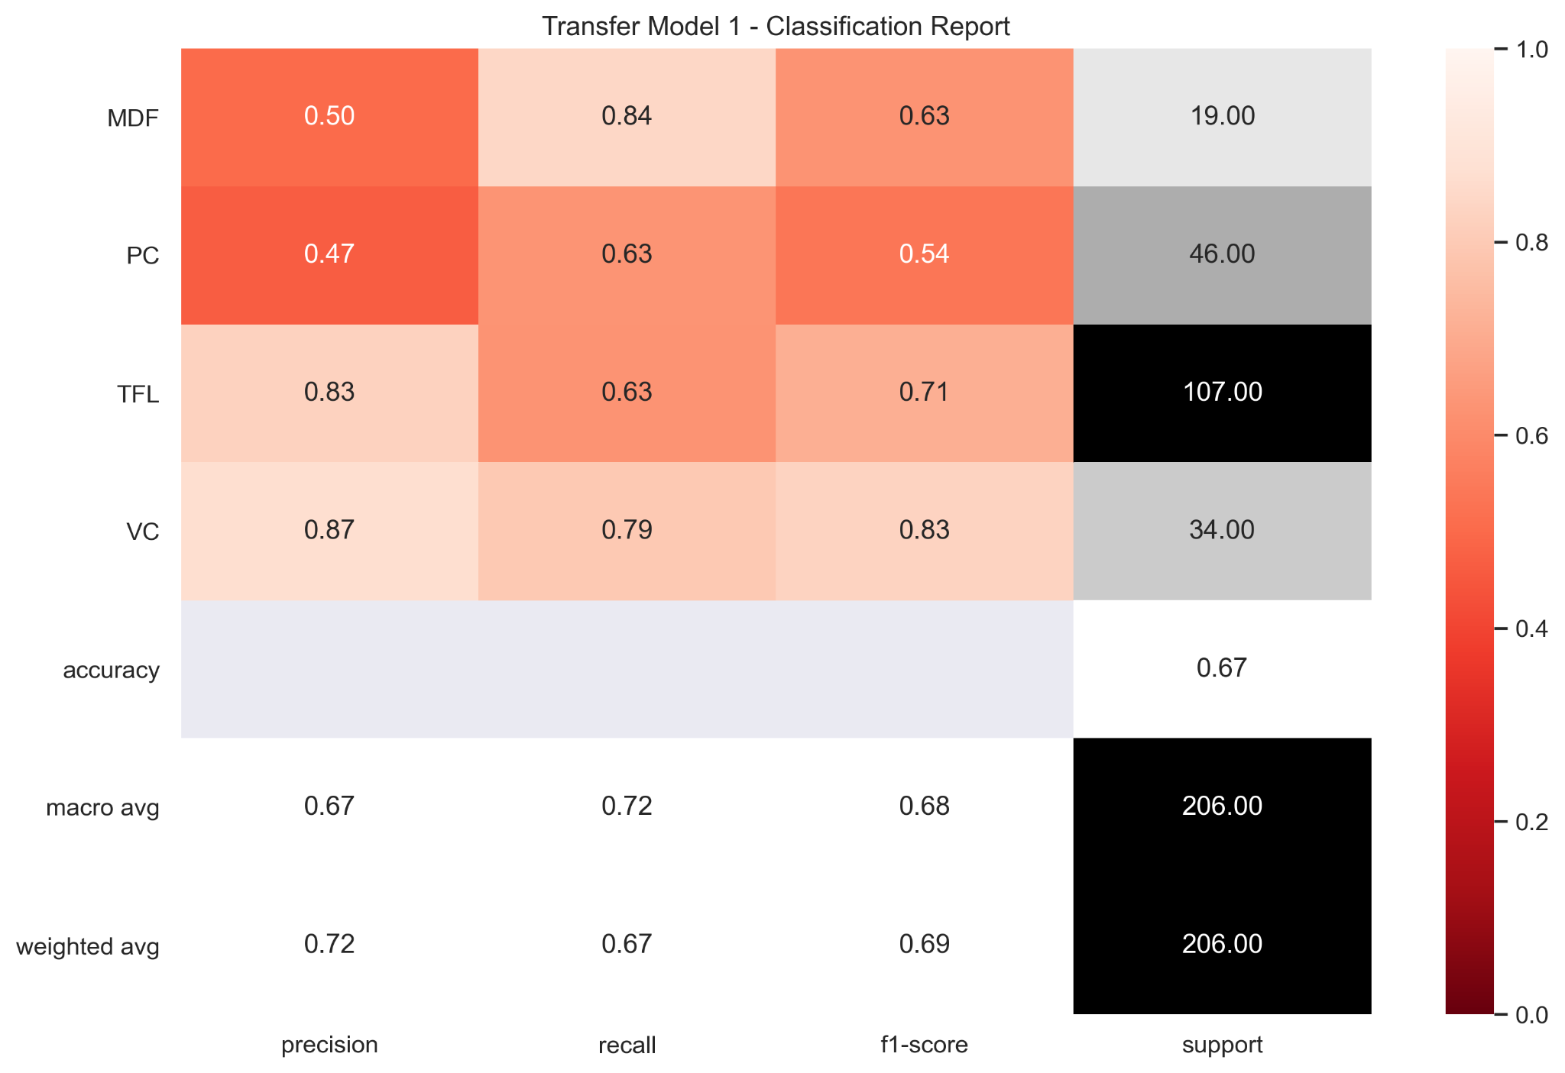
Data

Slide 19
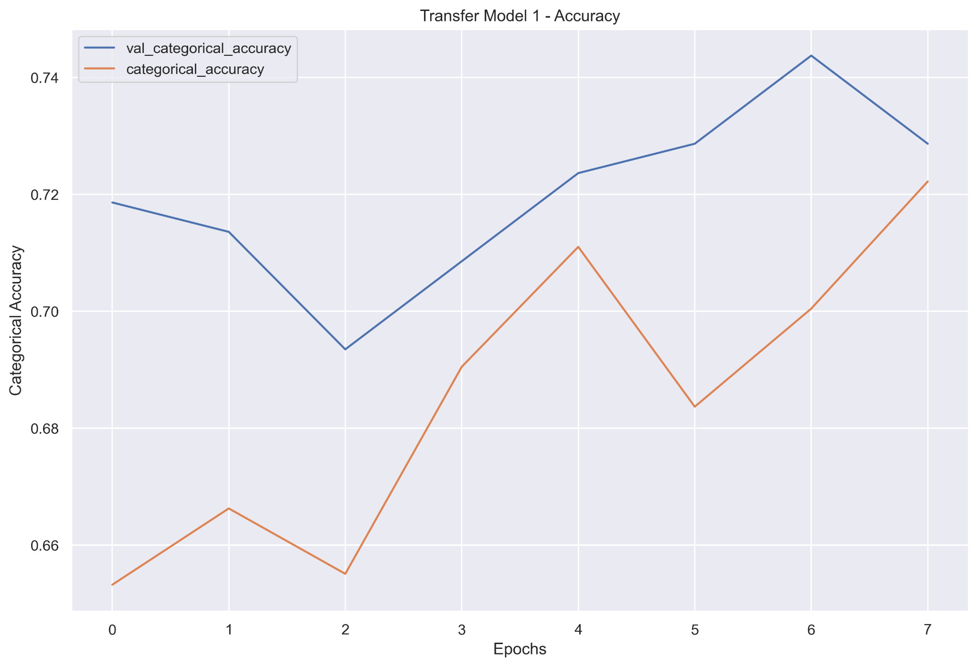
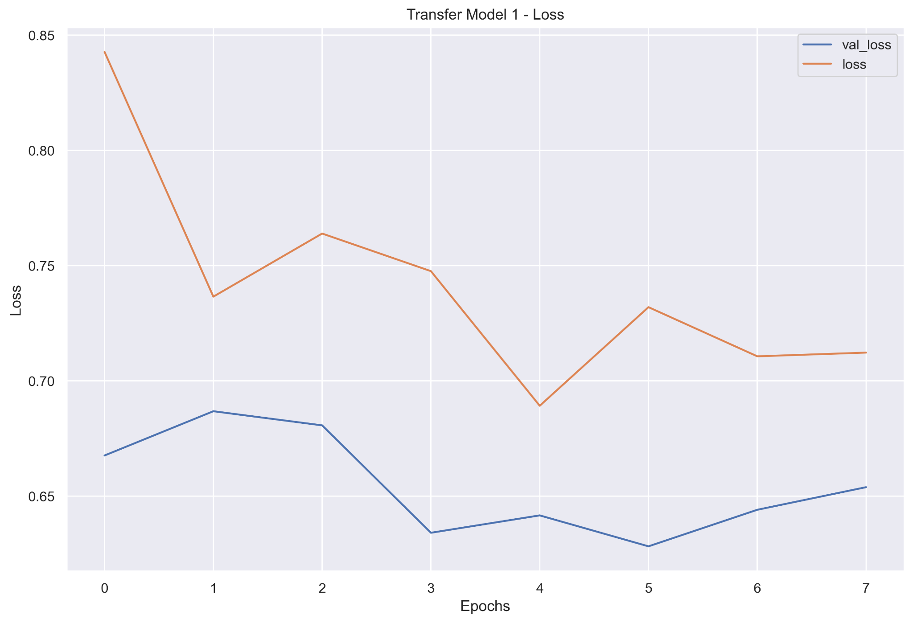
Data

Slide 20
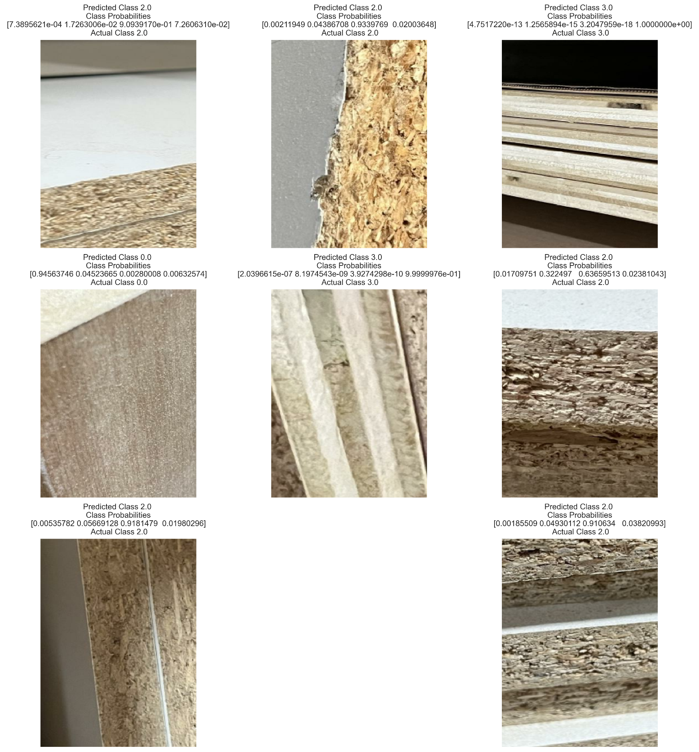
Data

Slide 21
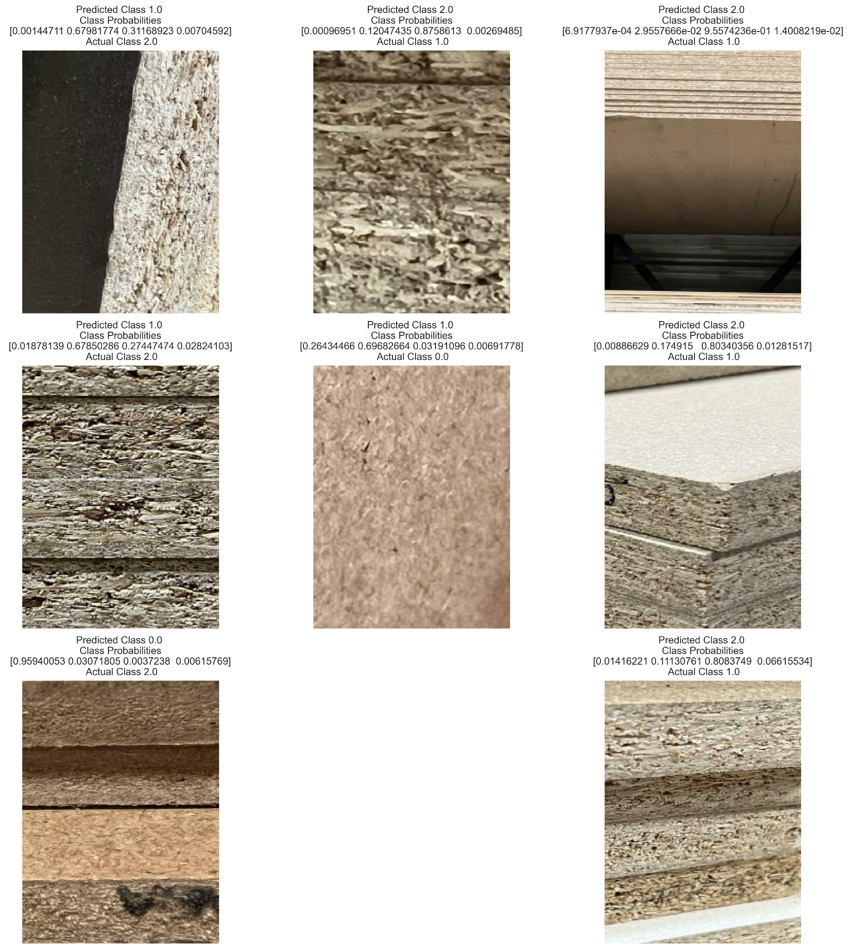
Data

